Slide 1

Reinforcement Learning
Xing Daiyan
50015641
dxing004@connect.hkust-gz.edu.cn

Slide 2
Reinforcement Learning in 3 Hours | Full Course using Python
Reinforcement learning focuses on teaching agents through trial and error, based on actively engaging with an environment.
How to do the optimization is the main challenge in RL
Some important links
Get the code for this tutorial: https://github.com/nicknochnack/ReinforcementLearningCourse
Links Mentioned
Stable Baselines 3: https://stable-baselines3.readthedocs.io/en/master/
OpenAI Gym: https://gym.openai.com/
PyTorch: https://pytorch.org/
Atarimania ROMs: http://www.atarimania.com/roms/Roms.rar
Swig: http://www.swig.org/Doc1.3/Windows.html

Slide 3
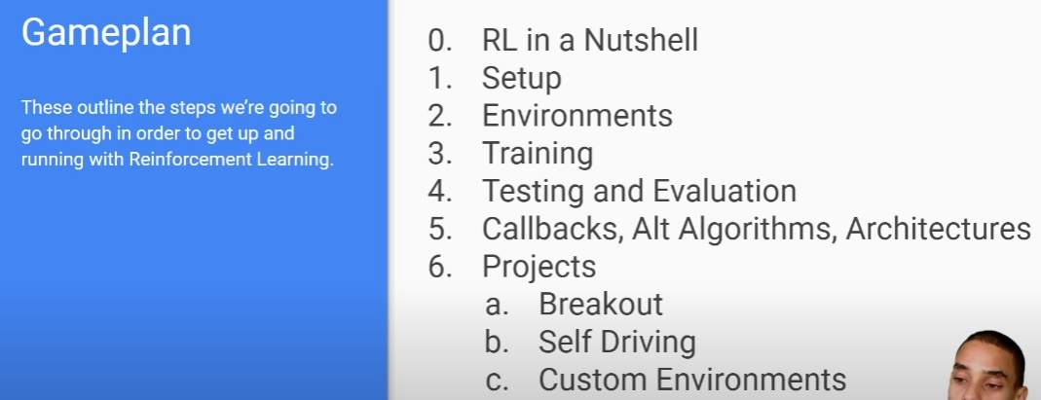
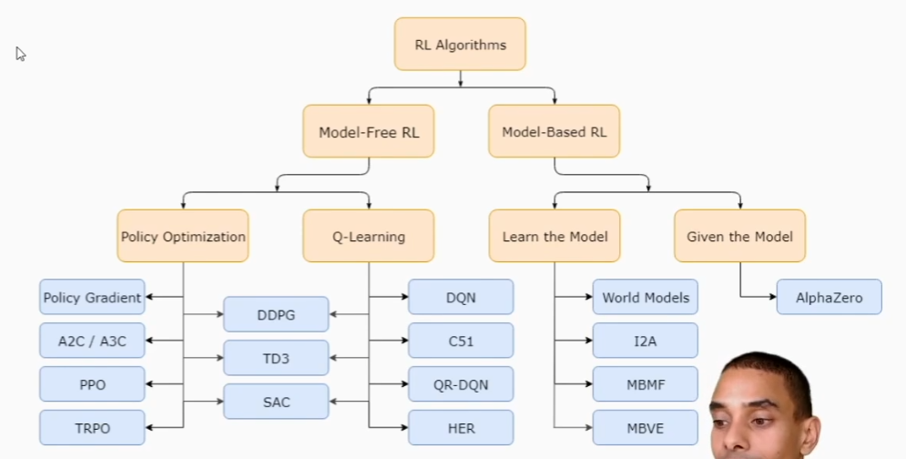
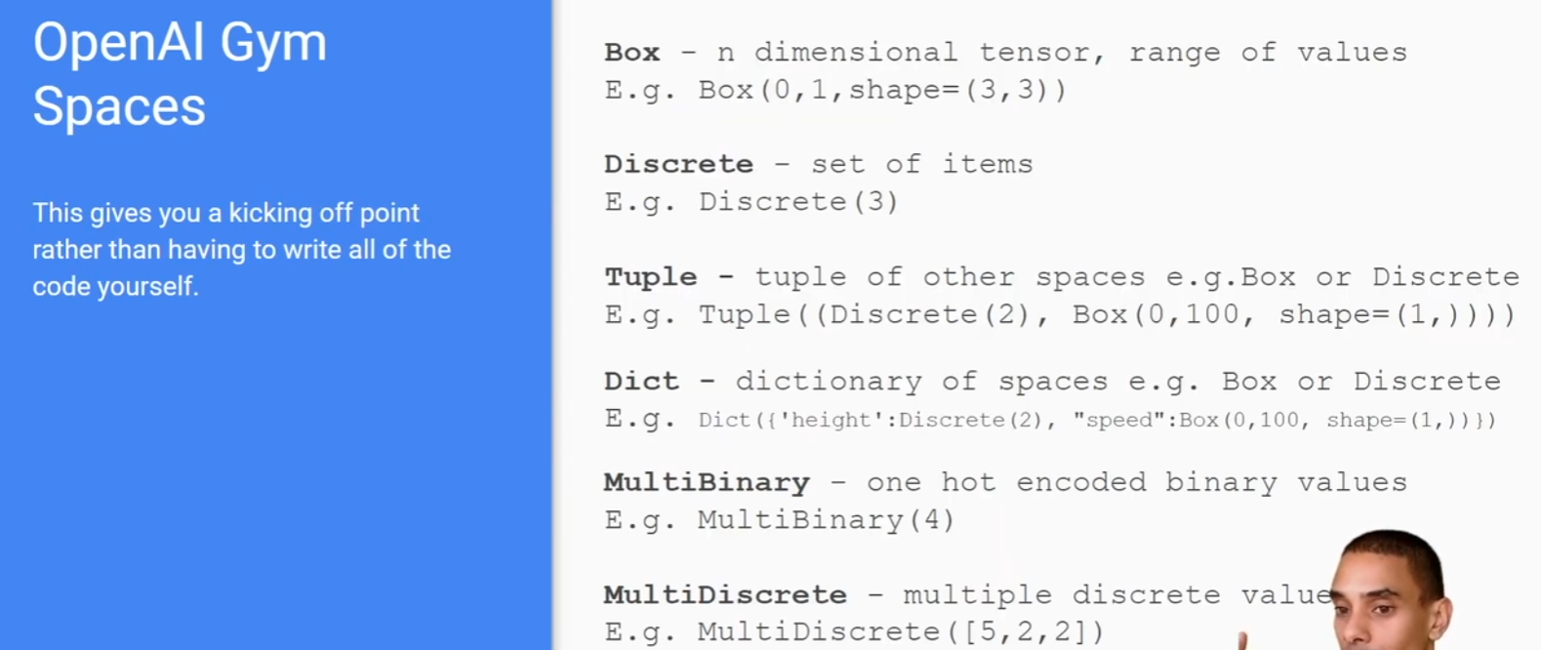
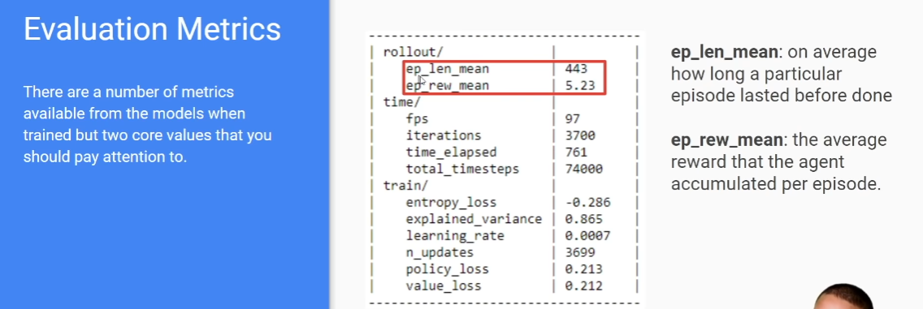
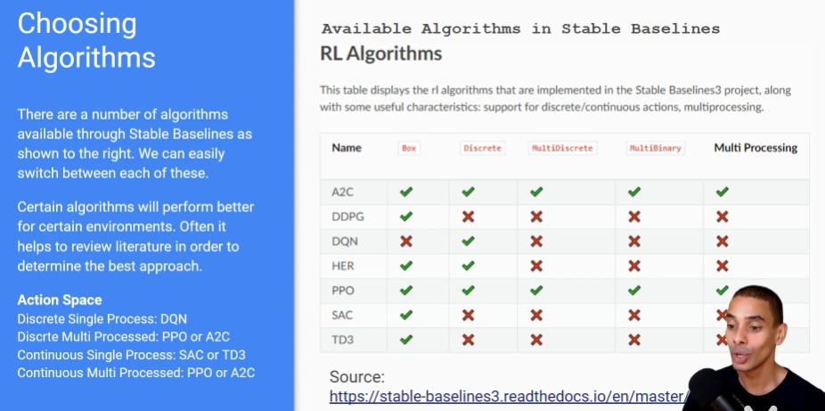
Reinforcement Learning in 3 Hours | Full Course using Python
core metrics to look at
Average Reward
Average Episode Length
Training Strategies
Train for Longer
Hyperparameter Tuning
Try Different Algorithms

Slide 4
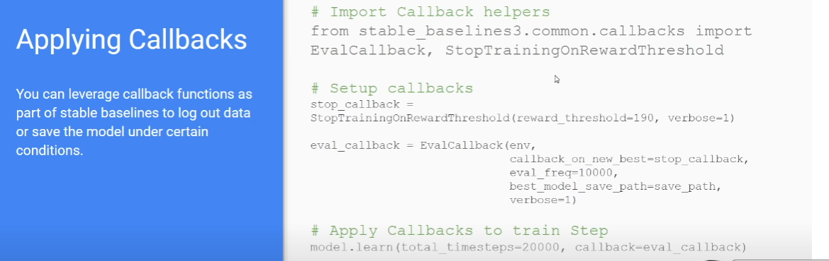
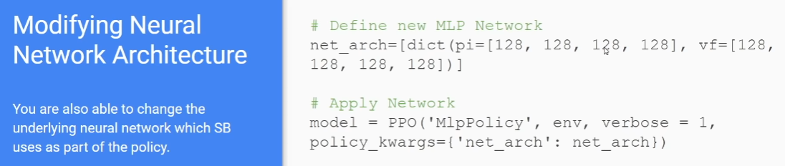
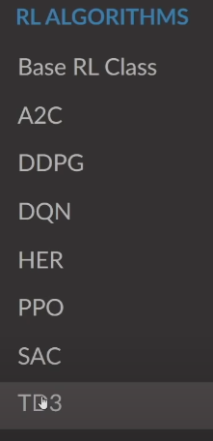
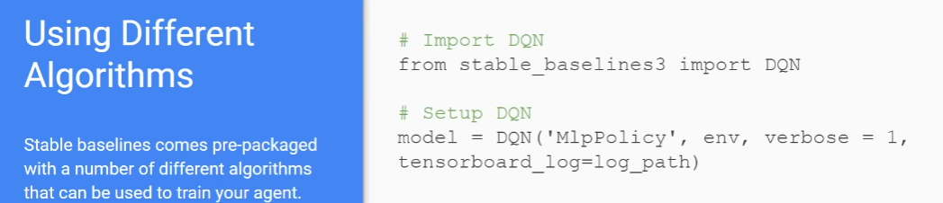
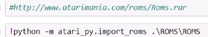
Reinforcement Learning in 3 Hours | Full Course using Python
DQN (Deep Q-Network)
DQN is a reinforcement learning algorithm that combines the principles of deep learning and Q-learning.
It utilizes deep neural networks to approximate the action-value function and optimize the decision-making policy through learning network parameters.
The core idea of DQN is to maximize cumulative rewards in order to learn the optimal action strategy.
Experience replay is a key technique used in DQN, which improves learning efficiency and stability by storing and reusing the agent's experiences with the environment.
Another important enhancement is the use of target networks, which addresses the issue of estimation bias in DQN. Target networks involve using a fixed older network to compute target Q-values, reducing target fluctuations.
DQN has achieved remarkable success in solving problems with discrete action spaces, particularly in applications such as Atari games.
The success of DQN has inspired the development of subsequent algorithms, including Double DQN, Deep Deterministic Policy Gradient (DDPG), and Proximal Policy Optimization (PPO).
3 projects
https://github.com/nicknochnack/ReinforcementLearningCourse
breakout
model = A2C("CnnPolicy", env, verbose=1, tensorboard_log=log_path) ##CNN:image
self driving
model = PPO("CnnPolicy", env, verbose=1, tensorboard_log=log_path)
custom environmnent
model = PPO("MlpPolicy", env, verbose=1, tensorboard_log=log_path)##MLP:tabular data/observations

Slide 5
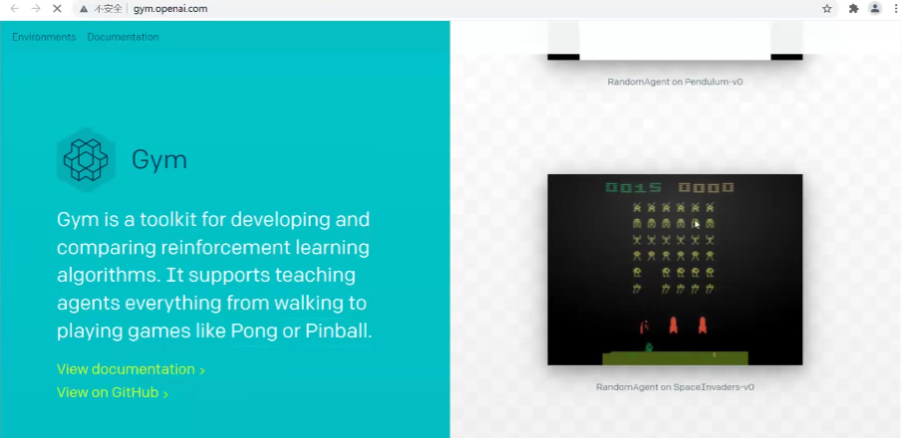
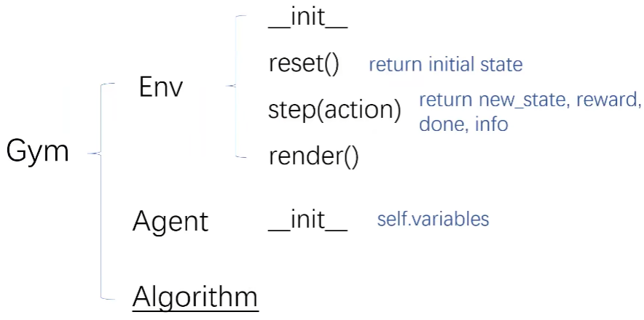
Gym
Gym is a standard API for reinforcement learning, and a diverse collection of reference environments

Slide 6
Basic Algorithms
Markov Decision Process (MDP)
A mathematical framework used to describe reinforcement learning problems. It consists of a set of states, a set of possible actions, state transition probabilities, and a reward function. MDP is used to model the decision-making process of an agent in an environment.
Policy Iteration
An iterative algorithm used to find the optimal policy in an MDP. It involves iteratively improving the policy by evaluating and updating it until the optimal policy is found.
Value Iteration
An iterative algorithm used to find the optimal value function in an MDP. It iteratively updates the value estimates for each state until it converges to the optimal value function.
Generalized Iteration
An iterative algorithm used to solve reinforcement learning problems with uncertainty. It involves iteratively updating confidence intervals or upper bounds to find the optimal policy or value function in situations where the environment has uncertainties.
https://www.bilibili.com/video/BV1Pi4y1Z7Tp

Slide 7
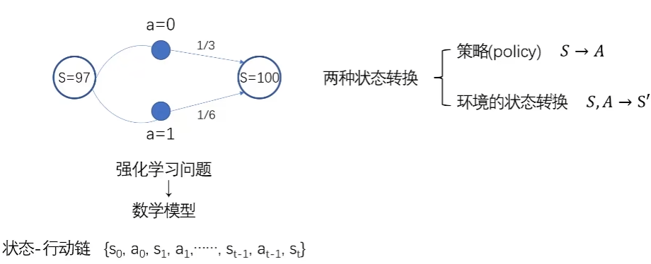
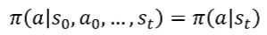
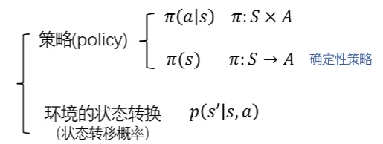
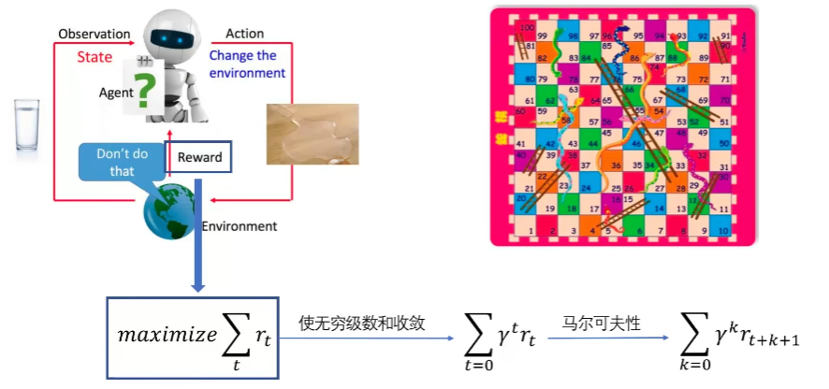
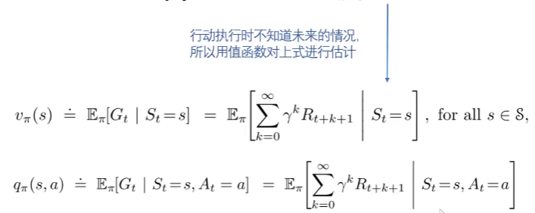
Markov Decision Process (MDP)
Markov Property:
The property that the action at the next time step depends only on the current state and is independent of the states prior to the current time step.
https://www.bilibili.com/video/BV1Pi4y1Z7Tp

Slide 8
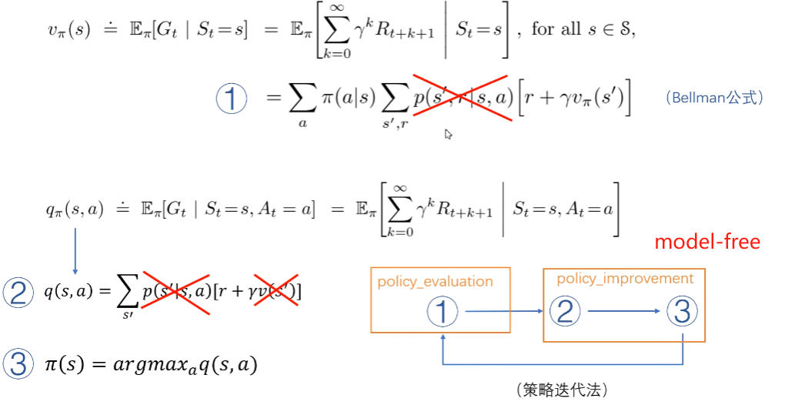
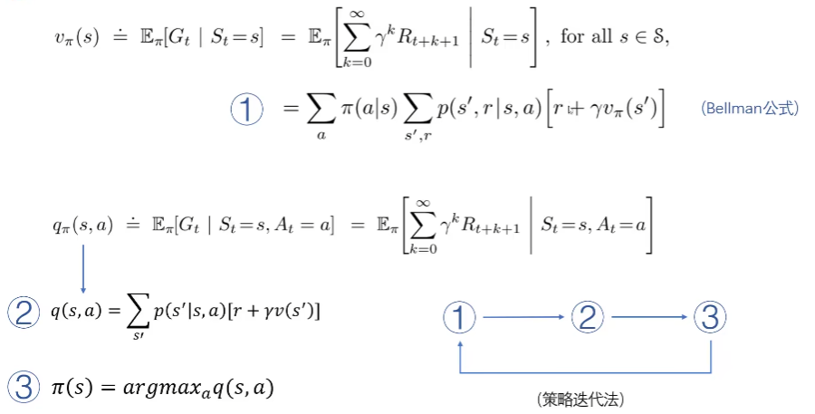
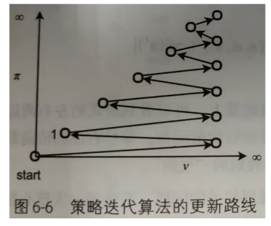
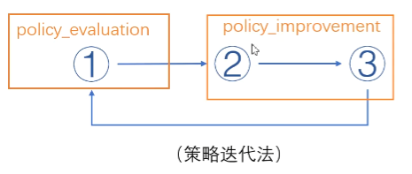
Policy Iteration
https://www.bilibili.com/video/BV1Pi4y1Z7Tp

Slide 9
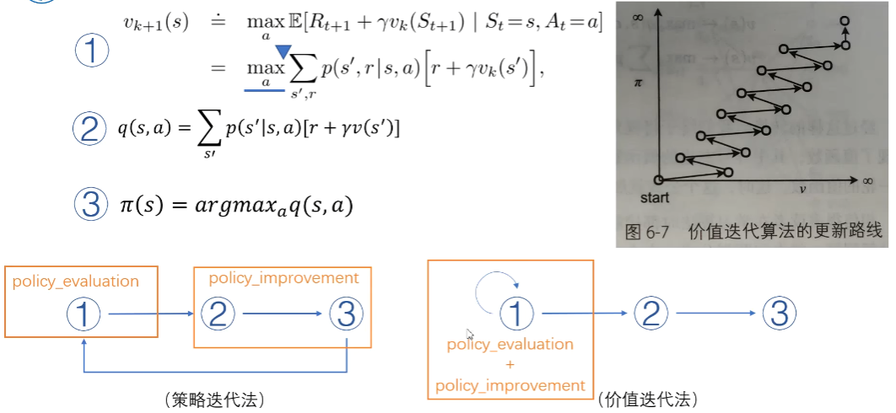
Value Iteration
https://www.bilibili.com/video/BV1VY411W7Mm

Slide 10
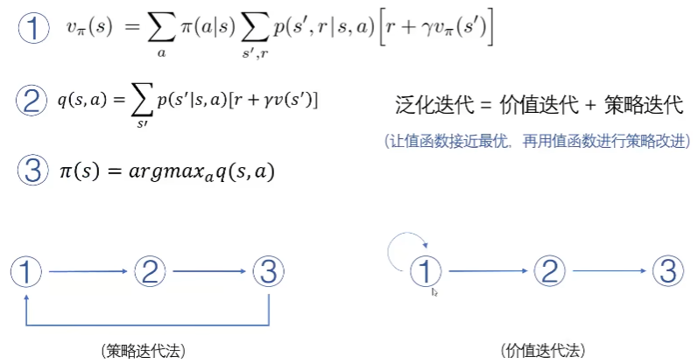
Generalized Iteration
https://www.bilibili.com/video/BV1Pi4y1Z7Tp

Slide 11
Basic Algorithms
Q-Learning
Q-Learning is a value-based reinforcement learning algorithm used to solve the problem of finding the optimal policy in a Markov Decision Process. It iteratively updates the value estimates (Q-values) for state-action pairs to find the optimal policy.
SARSA
SARSA is a value-based reinforcement learning algorithm also used to find the optimal policy in a Markov Decision Process. Unlike Q-Learning, SARSA considers the action taken in the current state when updating the Q-values and uses the Q-value of the next state and next action for the update.
DQN (Deep Q-Network)
DQN is a deep neural network-based reinforcement learning algorithm used to solve problems with high-dimensional state spaces. It combines Q-Learning with deep neural networks and learns the optimal policy by taking the state as input and outputting the Q-values for each action.
Policy Gradient
Policy Gradient is a policy-based reinforcement learning algorithm that directly learns the policy function instead of the value function. It updates the policy parameters using gradient ascent to maximize the cumulative reward.

Slide 12
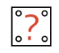
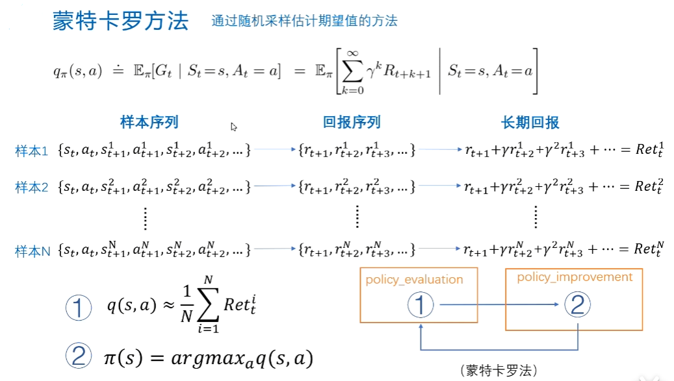
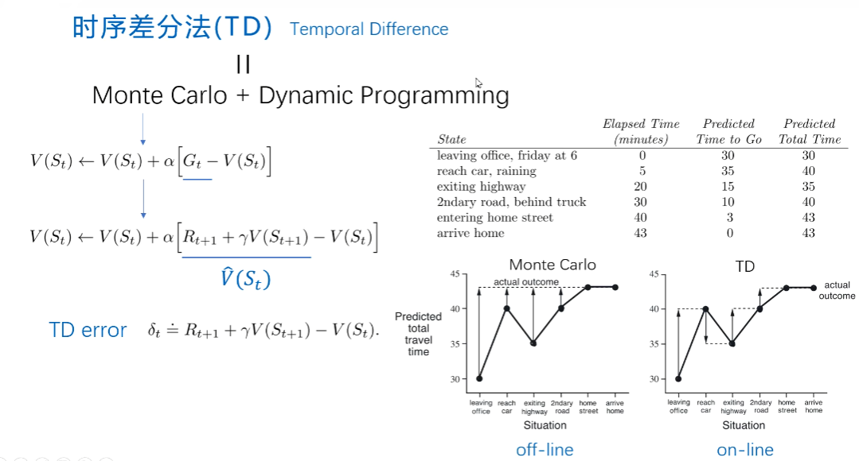
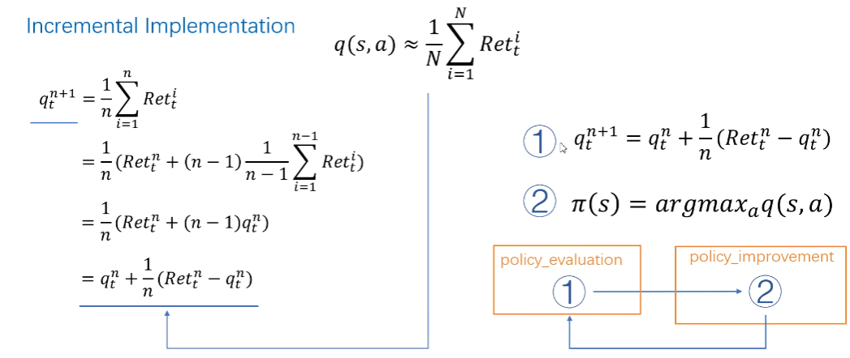
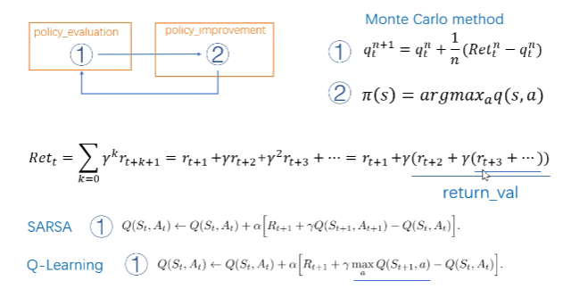
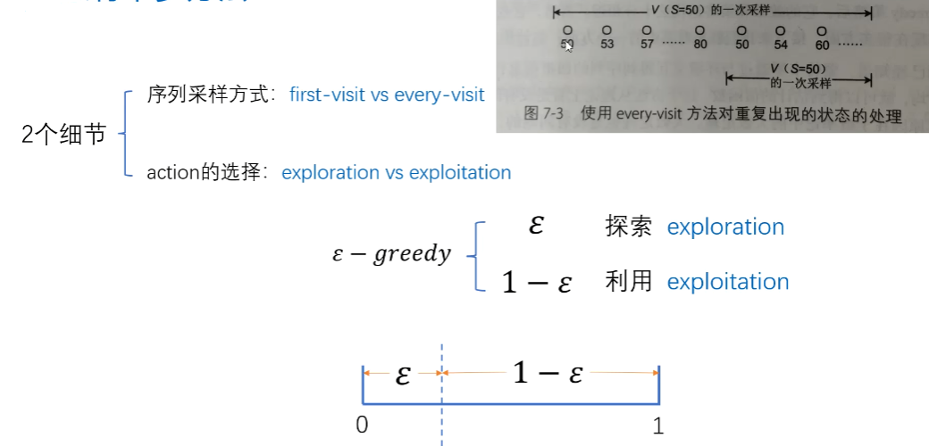
*Monte Carlo+TD
Compared to Monte Carlo, TD (Temporal Difference) has lower variance but higher error.
Independent sampling
unbiased
high variance
https://www.bilibili.com/video/BV1Au411S7Qv
Notes:
I found something complicated on my own, I can't understand it, I can't learn it, and I cried.o(╥﹏╥)o

Slide 13
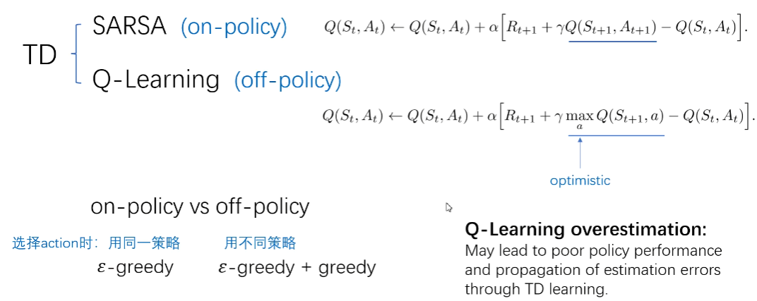
SARSA&Q-Learning
https://www.bilibili.com/video/BV1Au411S7Qv

Slide 14
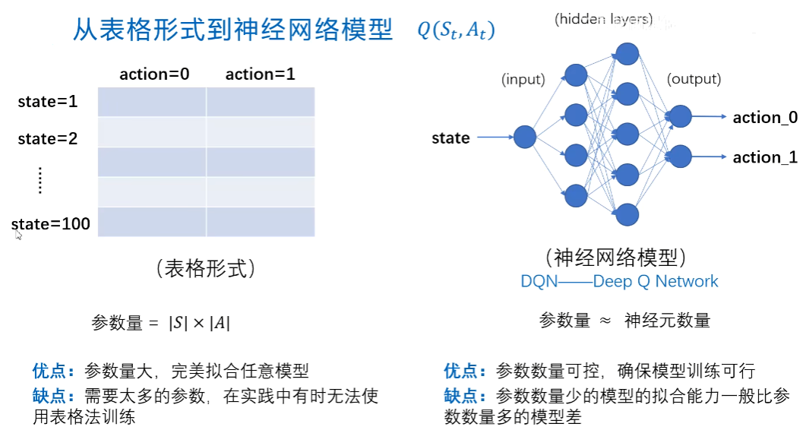
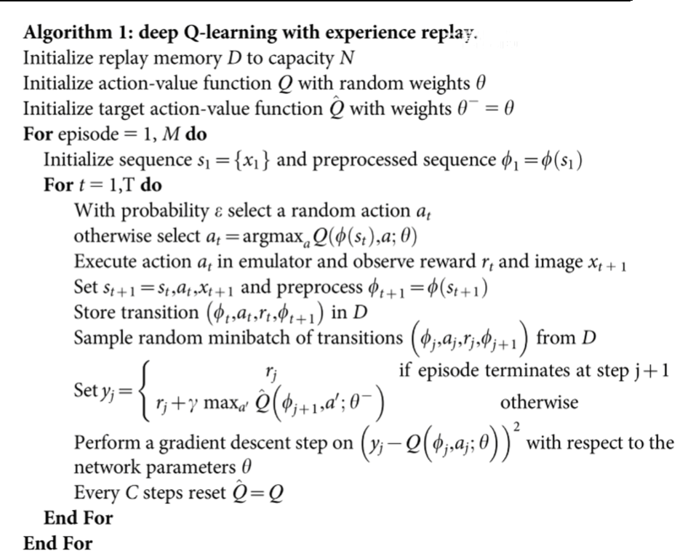
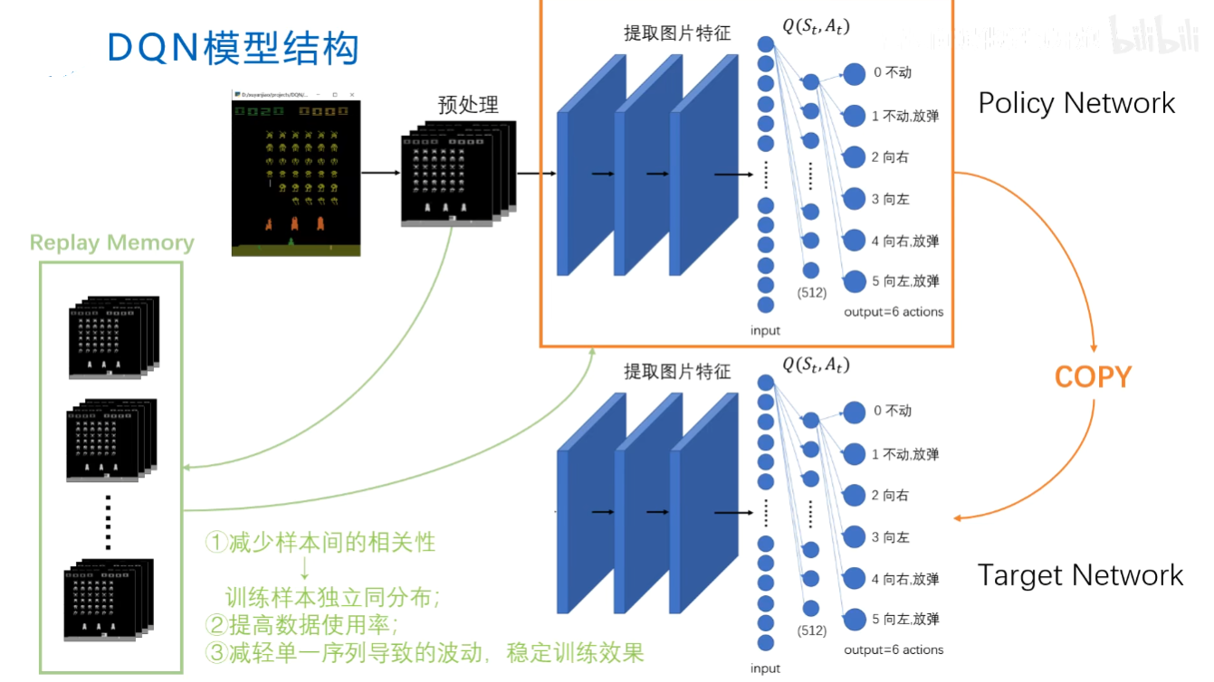
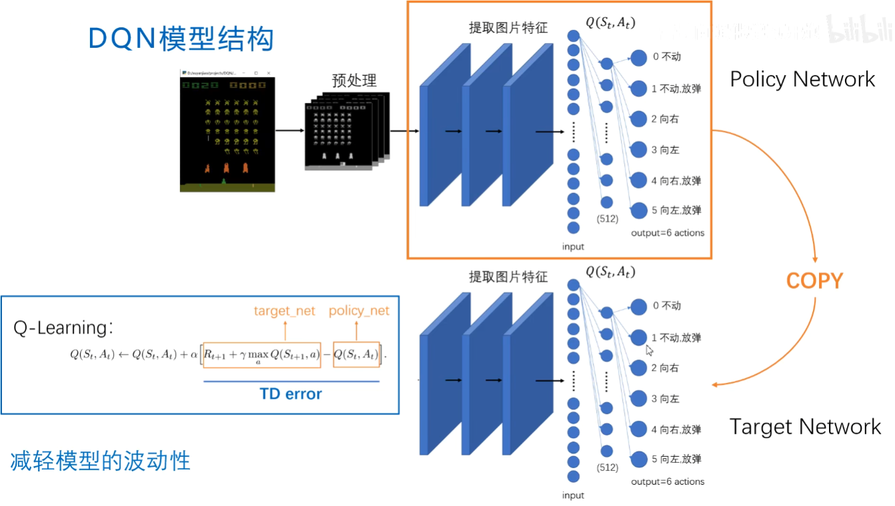
DQN
https://www.bilibili.com/video/BV1Rq4y1b7ML
Mnih, V., Kavukcuoglu, K., Silver, D. et al. Human-level control through deep reinforcement learning. Nature 518, 529–533 (2015). https://doi.org/10.1038/nature14236

Slide 15
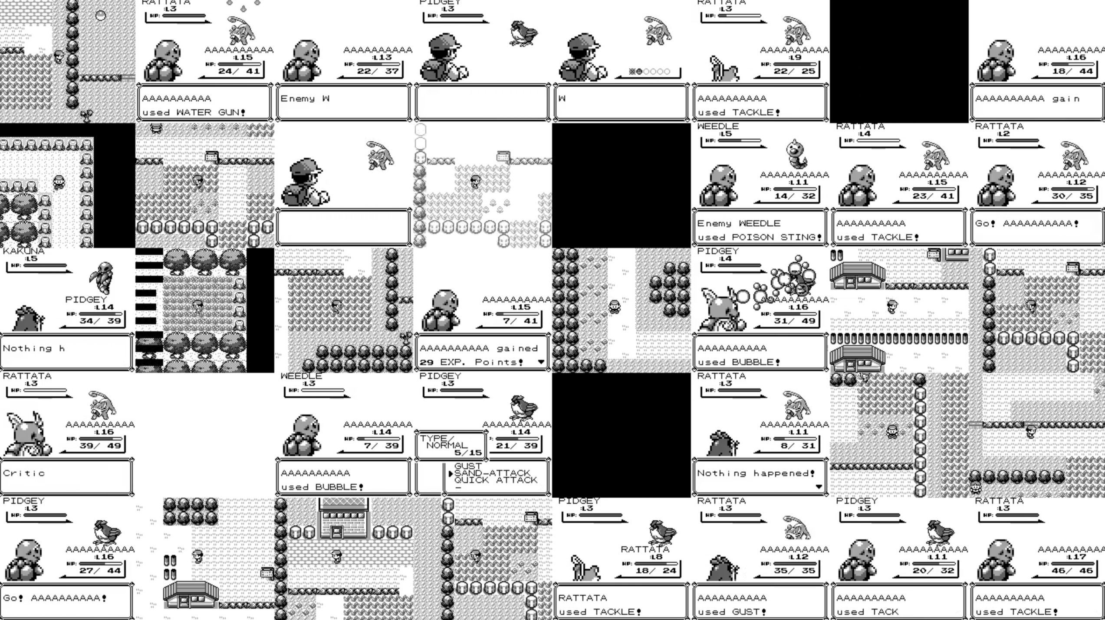
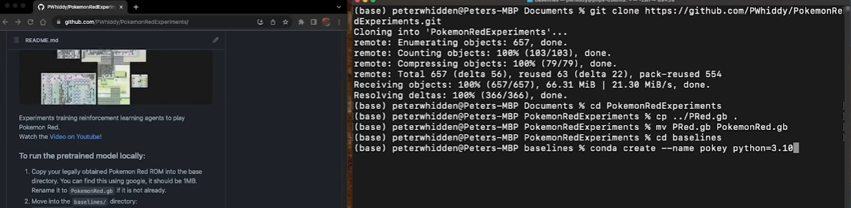
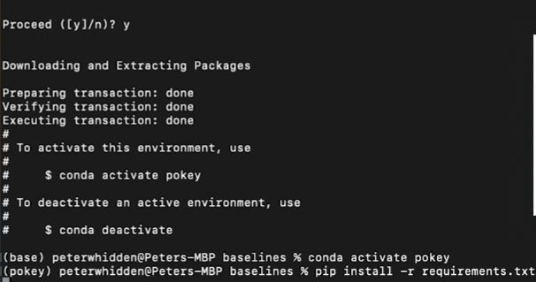
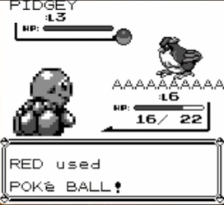
Project|Train RL agents to play Pokemon Red
https://github.com/PWhiddy/PokemonRedExperiments

Slide 16
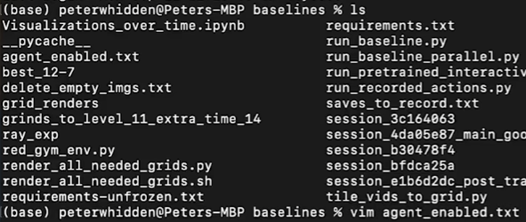
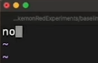
Project|Train RL agents to play Pokemon Red
no: AI will stop having any actions and we can take full control of the emulator.
yes: It will reactivate and continue playing.

Slide 17
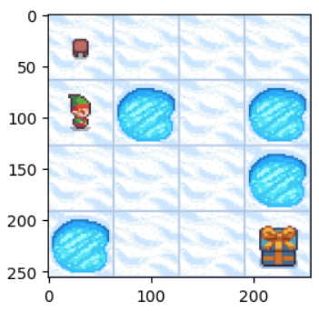
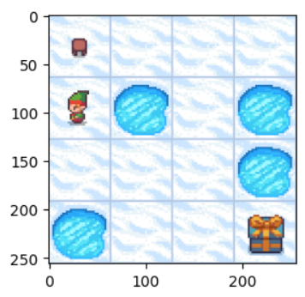
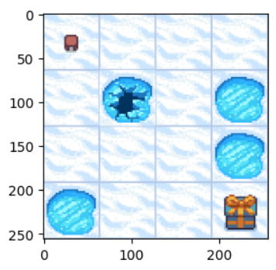
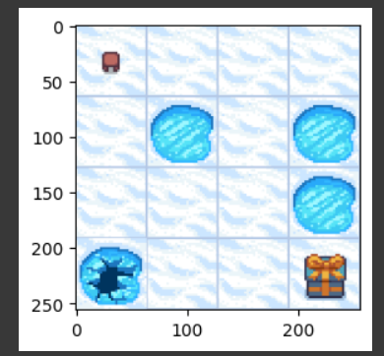
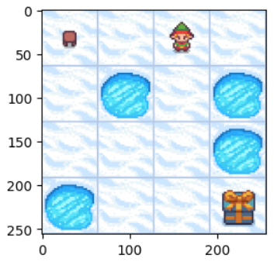
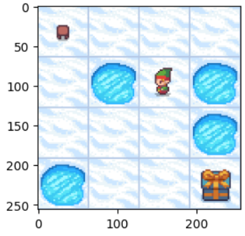
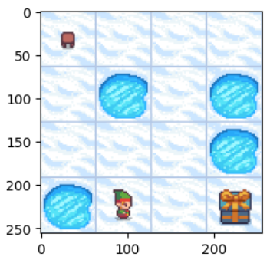
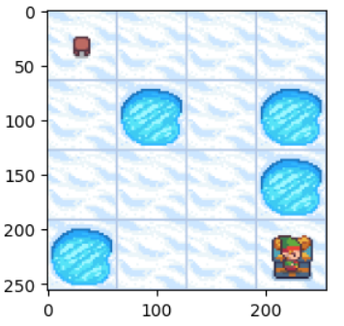
Project|QLearning FrozenLake-v1

